Slide 1
Case Study Managing Chemical Costs by Finding Optimal Alum Usage (Analyzing Alum effect on Settled Water Turbidity)

Slide 2
Problem: Alum costs are increasing
Symptoms:
Having trouble controlling Settled Water Turbidity
Monthly chemical bill increasing, over budget year to date
Higher than historical backwash frequencies - loss of production
Operators are changing dosing frequently based on gut feel. No consensus on dosing strategy.

Slide 3
Plan: Analyzing the problem
The principles of “Plan-Do-Check-Act” provide sustainable results.
Plan: Use WIMS to view Historic SCADA data from Hach Turbidity meters on Raw and Settled Water vs Alum usage entered manually by the Operators.
“Looking at single parameter is interesting, but combining the three parameters paints the big picture”
“The ability to combine any of our data (SCADA, Lab, Operator collected, calculations) quickly is an invaluable tool in managing a water plant”

Slide 4
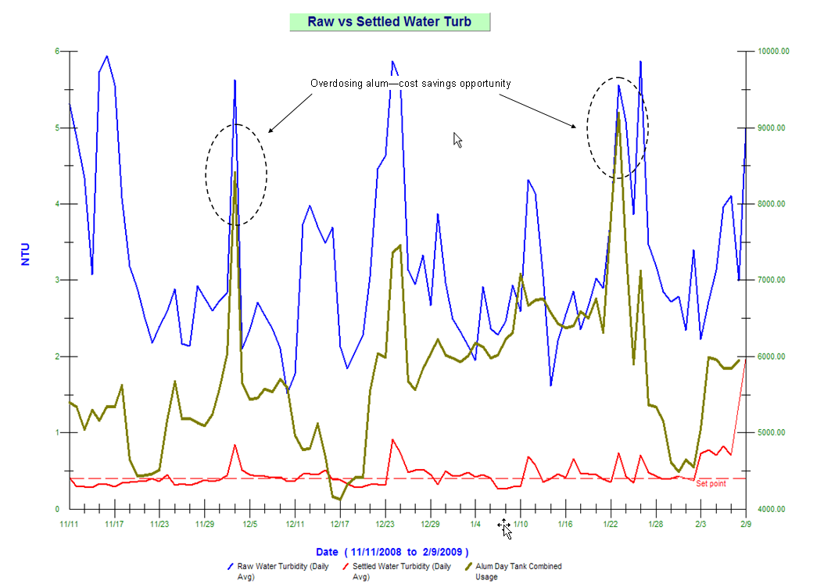
Plan: Identify the problem
The WIMS chart below shows that increased alum dosing (circled) did not improve settled water turbidity. This led to an opportunity to save up to 10 percent in alum dosage.
The data shows to dose based on Raw Water Turbidity/demand but never dose more than 6500 lbs/day.
Notes:
4

Slide 5
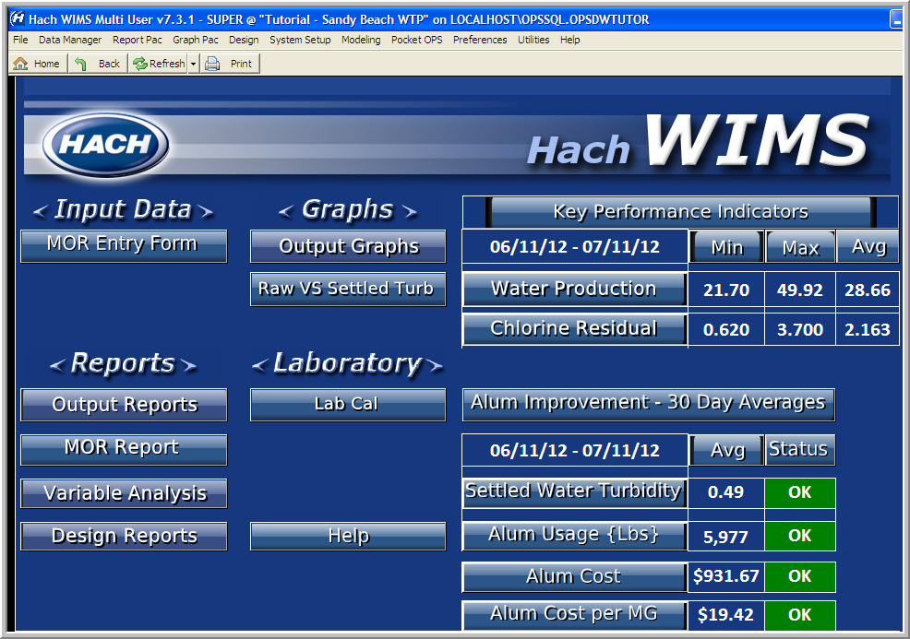
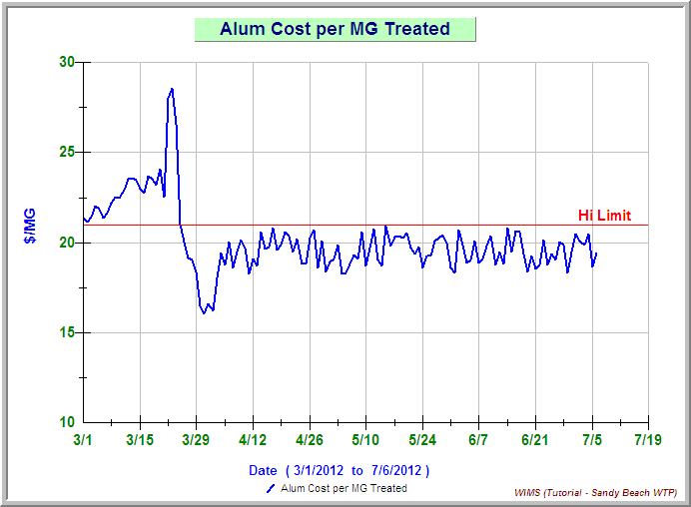
Do-Check: Sustainability
Best Management Practices say it is not enough to simply identify the problem
and formulate a solution. They must be sustainable to gain maximum benefit!
Sustainability is achieved by:
Clearly defining goals
Continuous monitoring and improvement
Corrective action taken resulting in long term benefits
Monitoring becomes easy
Useful graphs are one click away
Notes:
5

Slide 6
Act: Results and Continuous Improvement
Savings achieved:
10% savings on chemical usage (~10K/yr per MGD)
Better time management
Consistent settled water turbidities requires less frequent backwash:
Increased capacity
Less wasted finished water
Management by exception:
Dashboards allow easy monitoring for sustainability
Notification by email or mobile devices for fast response to potential problems
Everyone is Making Data-Driven Decisions:
Data clearly shows trends, issues and improvements
Data provides visibility
Data used to communicate more effectively
Everyone knows what the goal is and how to achieve it
Notes:
6

